Slide 1



CHAOTIX
VOCRYPT
WHEN MACHINES FIND THEIR OWN VOICE

Slide 2

CHAOTIX
PROBLEM STATEMENT
Why let machines whisper in human tongue? We make them speak encrypted—fast, and unhackable.

Slide 3


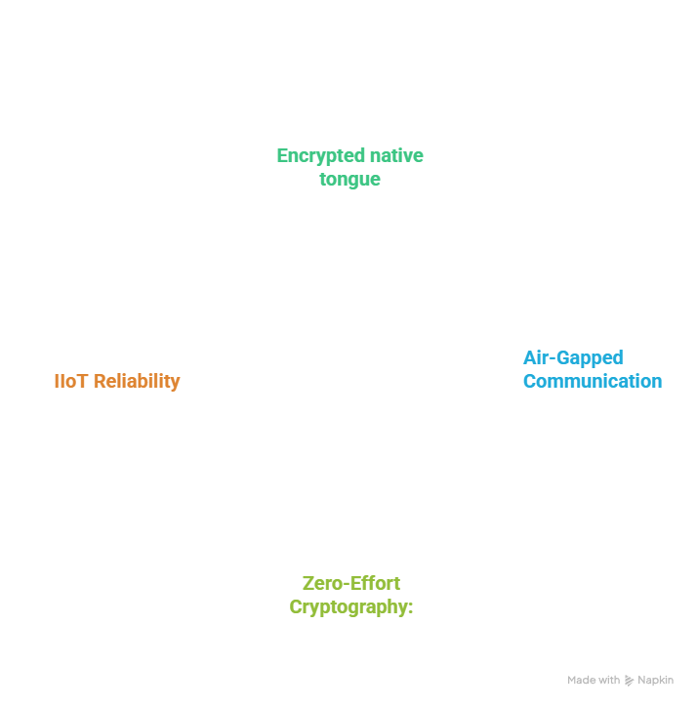
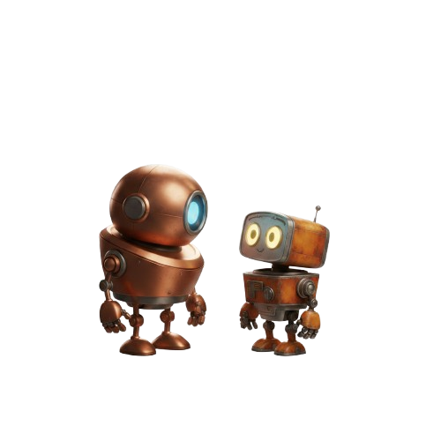

SOLUTION
CHAOTIX

Slide 4
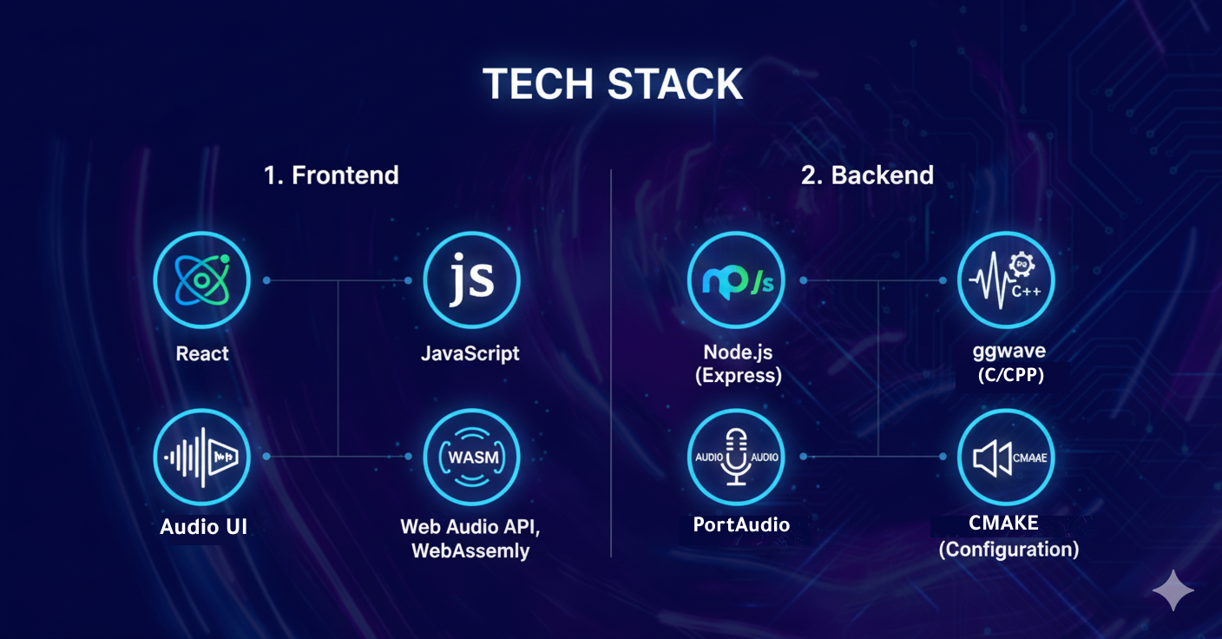
CHAOTIX
TECHSTACK
02

Slide 5


CHAOTIX
USE CASES
Immutable Root-of-Trust Provisioning: Securely "burn" cryptographic keys into headless IoT chips during manufacturing via non-physical acoustic blast. This eliminates vulnerable physical programming ports (JTAG/USB) and prevents supply chain attacks.
Centralized Status Broadcast: Enable a single central hub to broadcast an identical, brief message to many devices or machines simultaneously across an acoustic range, ensuring mass update without individual connections.

Slide 6
CHAOTIX
USE CASES
Decentralized Swarm Coordination: Enable drones and robots to exchange critical status and coordination data locally via sound, ensuring robust collective action and operational resilience without relying on a centralized network.
Low-Cost POS for Feature Phones: Facilitate financial inclusion in developing markets by allowing basic feature phones to transmit/receive secure, tokenized payment data via their built-in microphone and speaker, enabling mobile payments without 4G or NFC.

